Slide 1
Internet and Web Technology ICT- 2205 Lecture - 1
Presented By:
Mehrin Anannya
Lecturer
Institute of Information Technology
Jahangirnagar University.

Slide 2
Contents
Books to be Followed
Internet (Definition)
History of Internet
Web Technology (Definition)
Web Technology’s Different Sections
Network and Internet
Intranet and Extranet
Differences between Internet, Intranet and Extranet
Classification of Network on the basis of Geographical Area
Classification of Network on the basis of Role of Networked Computers
Web ≠ Internet

Slide 3
Books to be Followed
“Web Programming and Internet Technologies: An E-commerce Approach”, by Porter Scobey, PhD Saint Mary’s University Pawan Lingras, PhD; 2nd Edition
“Web Technology: Theory and practice”, by Akshi Kumar; 1st Edition
“Web Technologies: a computer science perspective”, by Jeffrey C Jackson; 1st Edition

Slide 4
Internet (Definition)
The Internet is a worldwide collection of computers and other devices connected by various means such as copper wire, fiber optics, and wireless communications of various kinds.
Businesses, governments, organizations, schools and universities, private homes, and “people on the go” are all “connected to the Internet”, or “wired”.

Slide 5
History of Internet
During the Second World War computers were innately expensive and isolated.
The pertinent literature published in the early 1960s substantiated the vision of building computer networks. As a meta-network, or network of networks, the Internet (acronym for INTERconnected NETwork) emerged to be a promising technology for providing ubiquitous access.
In 1969, ARPANET started as a federally funded research project, which was initiated by the Advanced Research Project Agency (ARPA) and the US Department of Defense (DoD).
Later, it was renamed the Internet.
ARPANET used the Transmission Control Protocol (TCP) for communication.
ARPA solved the problem by developing the Internet Protocol (IP), which truly created the network of networks—the current architecture of Internet.

Slide 6
Web Technology (Definition)
Web Technology refers to the various tools and techniques that are utilized in the process of communication between different types of devices over the internet.
Its a method by which computers communicate with each other through the use of markup languages and multimedia packages.

Slide 7
Web Technology’s Different Sections
World Wide Web (WWW): It is a “software infrastructure” consisting of many different communication standards for gaining access and exchanging information over, the Internet. The World Wide Web is based on several different technologies.
Web Clients: A web client is software that accesses a web server by sending an HTTP request message and processing the resulting HTTP response.

Slide 8
Web Server: Web server is a program which processes the network requests of the users and serves them with files that create web pages.
Web Pages: A webpage is a digital document that is linked to the World Wide Web and viewable by anyone connected to the internet has a web browser. It can be static or dynamic.
Web Development: Web development refers to the building, creating, and maintaining of websites. It includes aspects such as web design, web publishing, web programming, and database management.
API: API is an abbreviation for Application Programming Interface which is a collection of communication protocols.
Example: HTTP, TCP/IP Model, UDP, FTP, SMTP, SOAP.

Slide 9
Network and Internet
A network is a communication system for connecting end-systems.
Internetwork (INTERconnected NETwork or Internet) is an arbitrary collection of physical networks interconnected by routers to provide some sort of host-to-host packet delivery service.
The networks can primarily be classified either based on the transmission media used as wired or wireless.

Slide 10
Intranet and Extranet
1.Intranet: Intranet is owned by a single organization and is a tool for sharing information throughout the organization. It is the type of Internet that is used privately. In intranet, there are a limited number of connected devices as compared to internet. Intranet is highly secure and has a small number of visitors. It is used in order to get employee information, telephone directory etc.
2.Extranet: Extranet is owned by either a single or a many organization. It is managed on a contractual basis between organizations and is a tool for sharing information between the internal members and external members.

Slide 11
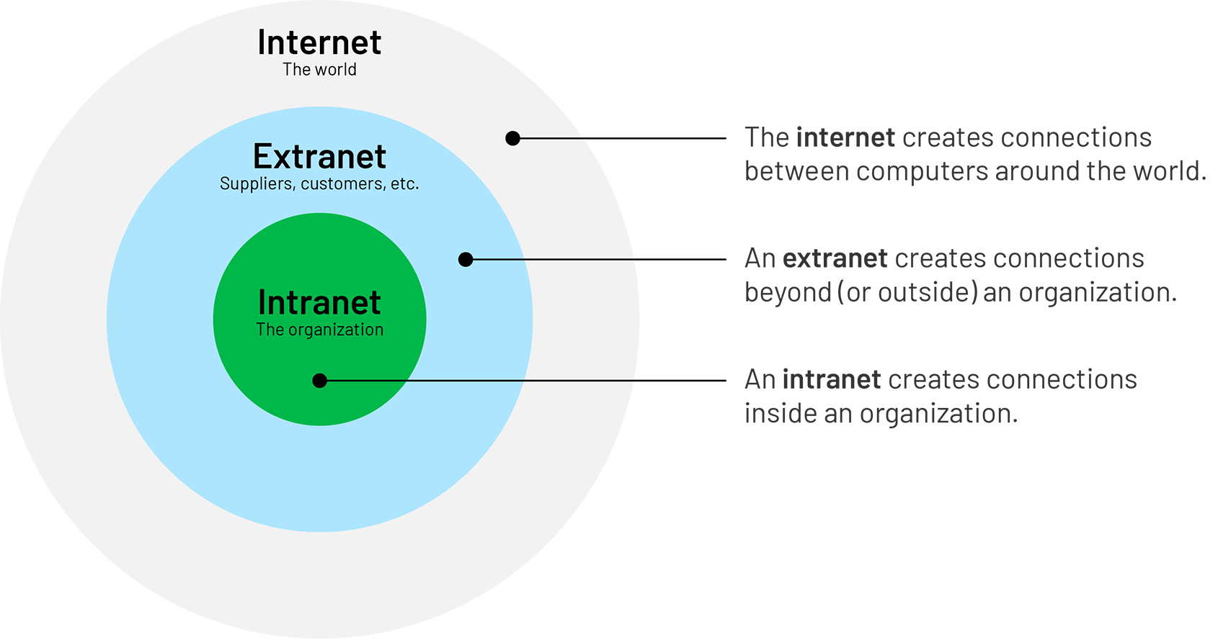
Intranet and Extranet (cont.)

Slide 12
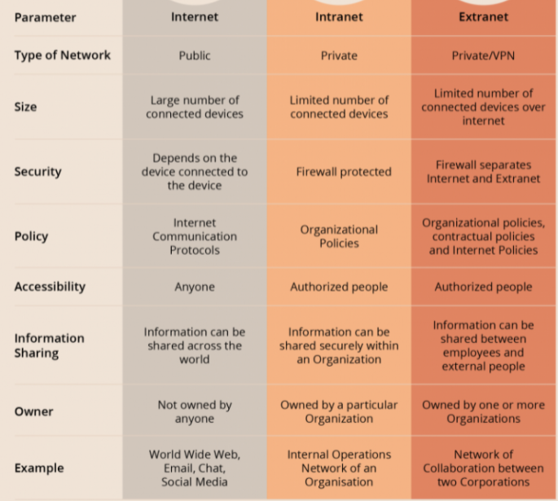
Differences between Internet, Intranet and Extranet

Slide 13
Classification of Network on the basis of Geographical Area
A Local Area Network (LAN) is a network that is used for communicating among computer devices, usually within an office building or home. Though it is limited in size, it is fast, with speeds from 10 Mbps to 10 Gbps, low cost, and high security. LANs can be either wired or wireless.
A Metropolitan Area Network (MAN) is optimized for a larger geographical area than a LAN, ranging from several blocks of buildings to entire cities, typically covering an area ranging from 5 to 50 km diametrically. As a high-speed network, MAN allows sharing of regional resources. It might be owned and operated by a single organization.
A Wide Area Network (WAN) covers a large geographic area such as country, continent or even whole world. It is two or multiple LANs connected using devices such as bridges, routers, or gateways, which enable them to share resources.

Slide 14
Classification of Network on the basis of Role of Networked Computers
Client/server network: In the client/server model, all end systems are divided into clients and servers, each designed for specific purposes. Clients have an active role and initiate a communication session by sending requests to servers. Clients must have knowledge of the available servers and the services they provide. Clients can communicate with servers only; they cannot see each other. A central computer, such as a workstation or server is a common source that provides shared services with other machines and manages resources in the network. Servers have a passive role and respond to their clients by acting on each request and returning results. One server generally supports numerous clients.

Slide 15
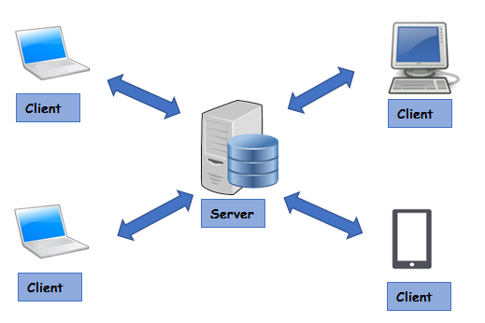
Classification of Network on the basis of Role of Networked Computers (cont.)
Client/server network (cont.):

Slide 16
Classification of Network on the basis of Role of Networked Computers (cont.)
Peer-to-peer network (P2P): In the P2P network architecture, all end systems have equivalent capabilities and responsibilities and either party can initiate a communication session. There is no central location for authenticating users, storing files, or accessing resources. The P2P model does not have the notion of clients or servers but only equal peers (a.k.a. servents, servent = SERVer + cliENT) that simultaneously function as both clients and servers. They are inexpensive, easy to install and extremely limited in scope. The accepted maximum number of peers that can operate on a peer-to-peer network is ten.

Slide 17
Classification of Network on the basis of Role of Networked Computers (cont.)
There are two types of P2P networks: Pure P2P Network and Hybrid P2P Network.
Pure P2P network: A P2P system that has no central service of any kind i.e., the entire communication occurs among connected peers without any assistance from any server is referred to as a pure P2P Network. Examples: Workgroups in Microsoft Windows Network, Gnutella, Freenet.

Slide 18
Classification of Network on the basis of Role of Networked Computers (cont.)
Hybrid P2P network: Pure P2P systems work well only in a small-scale environment. Hybrid P2P system depends partially on central servers or allocates selected functions to a subset of dedicated peers. Central servers act as central directories where either connected users or indexed content can be mapped to the current location. Dedicated peers directly control information among other peers. Thus, client/server and P2P systems are not mutually exclusive. Examples: Skype (voice-over-IP P2P application where the centralized server helps finding address of remote party and the real communication is a direct client-client connection not through server), BitTorrent.

Slide 19
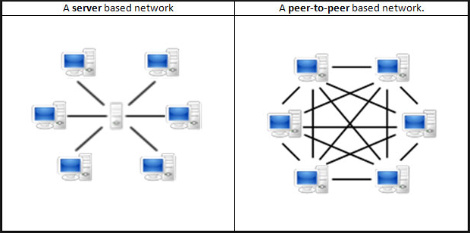
Classification of Network on the basis of Role of Networked Computers (cont.)
Hybrid P2P network:

Slide 20
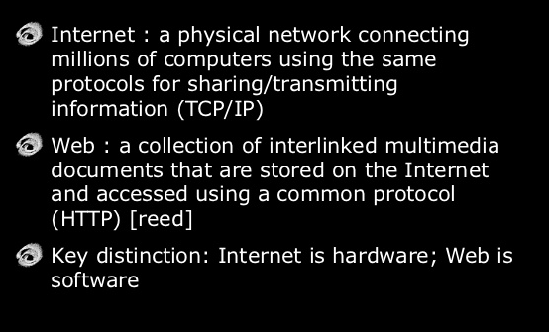
Web ≠ Internet

